Slide 1



INTERACTIVE DASHBOARD FOR BUSINESS STAKEHOLDERS USING POWER BI
CREATED BY
RAGINI.M.K

Slide 2
RETAIL SALES DASHBOARD PROJECT

Slide 3
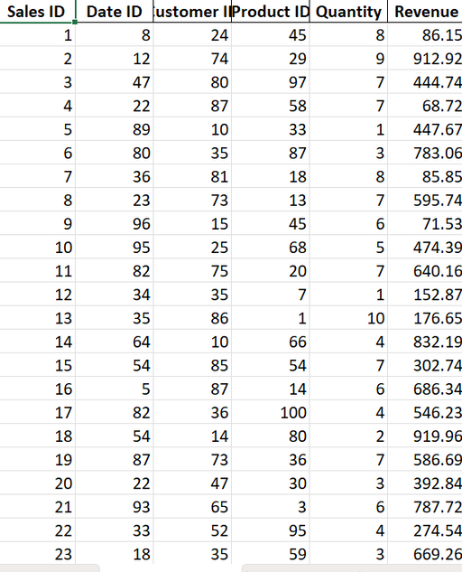
DATASET OVERVIEW
Dataset tracks product-level retail sales across Electronics, Toys, Clothing, and Home categories.
Key fields include: Category, Revenue, Price, Availability, Stock, Region, Month, and Quantity.
Ideal for analyzing sales trends, inventory levels, pricing, and regional performance.

Slide 4
DASHBOARD OVERVIEW
KPIs like Total Revenue, Total Quantity, and Total Population are shown via cards.
Visual Types:
Bar charts: Revenue & quantity comparisons
Pie charts: Average price distribution
Line & area charts: Time series trends
Tree maps: Regional GDP
Slicers/filters for month and category interactivity
Visualizations support business stakeholders in decision-making.

Slide 5
DASHBOARD VISUALS

Slide 6
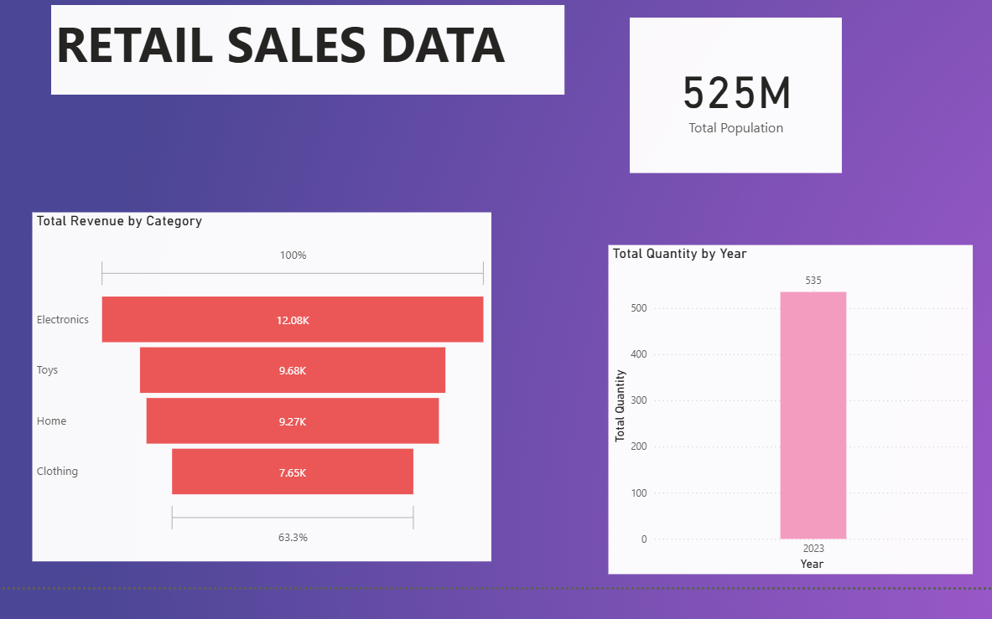
PART-1

Slide 7
INSIGHTS
🔴 Total Revenue by Category:
Electronics leads in revenue with 12.08K, followed by Toys and Home.
Clothing contributes the least revenue (7.65K).
🔴 Total Quantity by Year:
In 2023, a total of 535 units were sold across all categories.
🔴 Total Population (Card):
The market being analyzed has a potential customer base of 525 million.

Slide 8
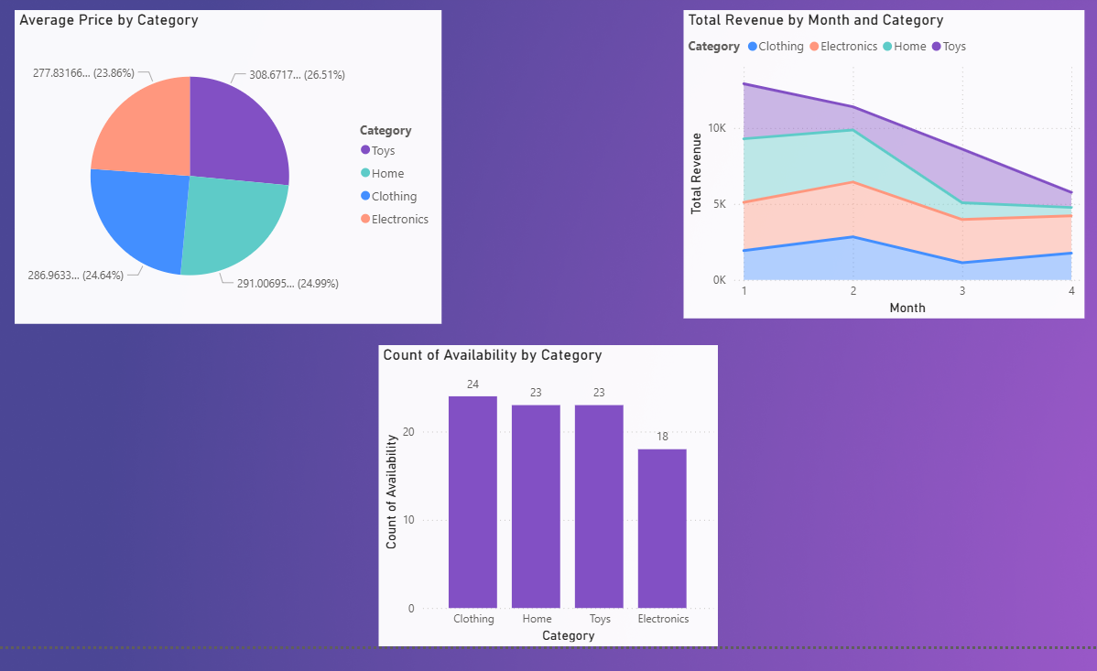
PART-2

Slide 9
INSIGHTS
🔵 Average Price by Category (Pie Chart):
Prices are evenly distributed across categories.
Toys have the highest average price (₹308), while Clothing has the lowest (₹286).
🔵 Total Revenue by Month and Category (Time Series Chart):
Electronics and Toys peaked in January and February.
Sales declined significantly in March and April for most categories.
🔵 Count of Availability by Category:
Clothing is the most available category (24 items), followed by Home and Toys.
Electronics has the lowest availability (18), which may affect sales.

Slide 10
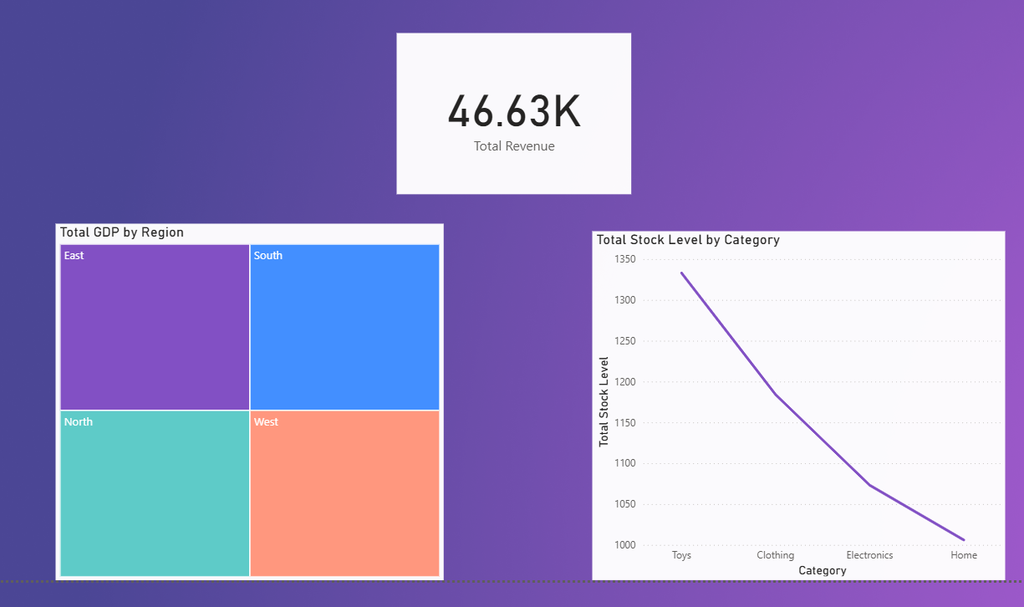
PART-3

Slide 11
INSIGHTS
🟣 Total Revenue (Card):
Total revenue across all categories and months is approximately ₹46.63K.
🟣 Total GDP by Region (Tree Map):
East and South regions are leading in economic contribution.
All four regions (East, South, North, West) are relatively balanced but East is slightly ahead.
🟣 Total Stock Level by Category (Line Chart):
Toys have the highest stock level (~1350 units).
Home has the lowest stock, potentially leading to stockouts if demand increases.
Stock decreases steadily from Toys → Clothing → Electronics → Home

Slide 12
Conclusions
Focus on restocking Home and Electronics to meet future demand.
Leverage Electronics’ high revenue performance with better availability and promotions.
Analyze why sales drop in March and April — consider seasonal marketing campaigns.
Target East and South regions for higher GDP alignment with growth plans

Slide 13
Thank You

